Slide 1

Lesson 6:
Maximum and Minimum

Slide 2


Introduction

Slide 3

Lecture Overview:
Goals of the lecture:
Find the maximum and minimum of a function

Slide 4
Maximum and Minimum

Slide 5
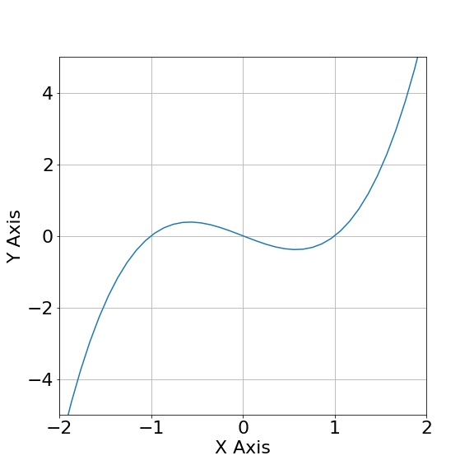

Finding Maximum and Minimum
$$f\left(x\right)= x^{3}−x$$
For which values of x do we have a maximum
and/or minimum?
Local Maximum
Local Minimum

Slide 6

Finding Maximum and Minimum
$$f\left(x\right)= x^{3}−x$$
For which values of x do we have a maximum
and/or minimum?
$$f^{′}\left(x\right)=3x^{2}−1=0$$
Local Maximum
Local Minimum

Slide 7

Finding Maximum and Minimum
$$f\left(x\right)= x^{3}−x$$
For which values of x do we have a maximum
and/or minimum?
$$f^{′}\left(x\right)=3x^{2}−1=0$$
Local Maximum
$$3x^{2}=1$$
Local Minimum

Slide 8

Finding Maximum and Minimum
$$f\left(x\right)= x^{3}−x$$
For which values of x do we have a maximum
and/or minimum?
$$f^{′}\left(x\right)=3x^{2}−1=0$$
Local Maximum
$$3x^{2}=1$$
Local Minimum
$$x^{2}=\frac{1}{3}$$

Slide 9

Finding Maximum and Minimum
$$f\left(x\right)= x^{3}−x$$
For which values of x do we have a maximum
and/or minimum?
$$f^{′}\left(x\right)=3x^{2}−1=0$$
Local Maximum
$$3x^{2}=1$$
$$x=±\sqrt{\frac{1}{3}}=±0.54$$
Local Minimum
$$x^{2}=\frac{1}{3}$$

Slide 10
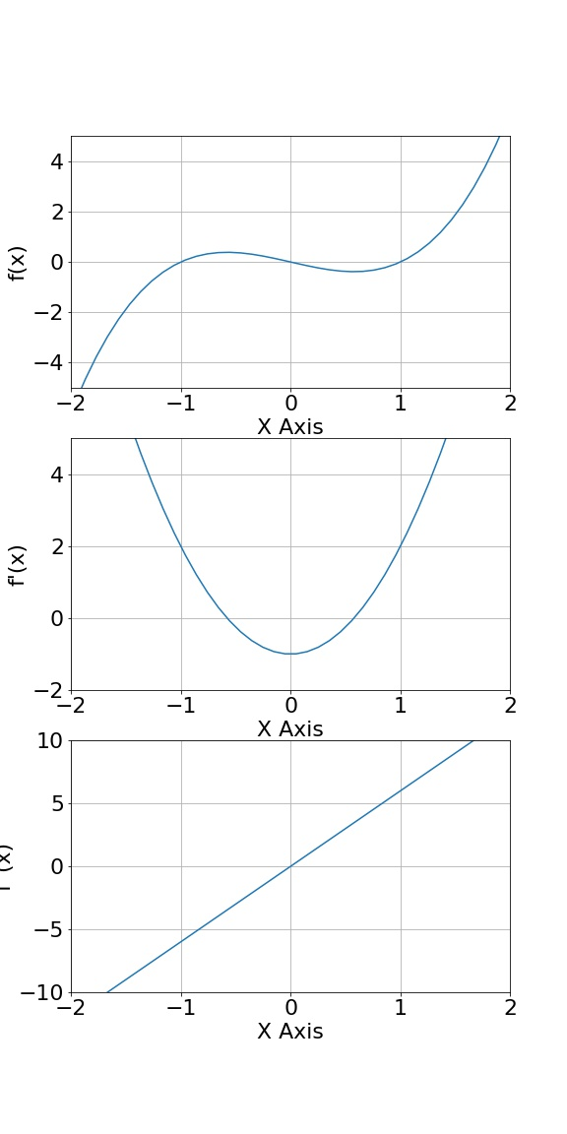



Concavity-Convexity
$$f\left(x\right)= x^{3}−x$$
$$f^{′}\left(x\right)=3x^{2}−1$$
$$f^{′′}\left(x\right)=6x$$

Slide 11
Concavity-Convexity
$$f\left(x\right)= x^{3}−x$$
$$f^{′}\left(x\right)=3x^{2}−1$$
$$f^{′′}\left(x\right)=6x$$

Slide 12
Concavity-Convexity
$$f\left(x\right)= x^{3}−x$$
$$f^{′}\left(x\right)=3x^{2}−1$$
$$f^{′′}\left(x\right)=6x$$

Slide 13
Concavity-Convexity
$$f\left(x\right)= x^{3}−x$$
Concave shapes f ’’(x) < 0
Convex shapes f ’’(x) > 0
$$f^{′}\left(x\right)=3x^{2}−1$$
$$f^{′′}\left(x\right)=6x$$

Slide 14
Concavity-Convexity
$$f\left(x\right)= x^{3}−x$$
Concave shapes f ’’(x) < 0
Convex shapes f ’’(x) > 0
$$f^{′}\left(x\right)=3x^{2}−1$$
Definition:
Maximum: f ’(x) = 0 and f ’’(x) < 0
Minimum: f ’(x) = 0 and f ’’(x) > 0
Neither: f ’(x) = 0 and f ’’(x) = 0
$$f^{′′}\left(x\right)=6x$$

Slide 15
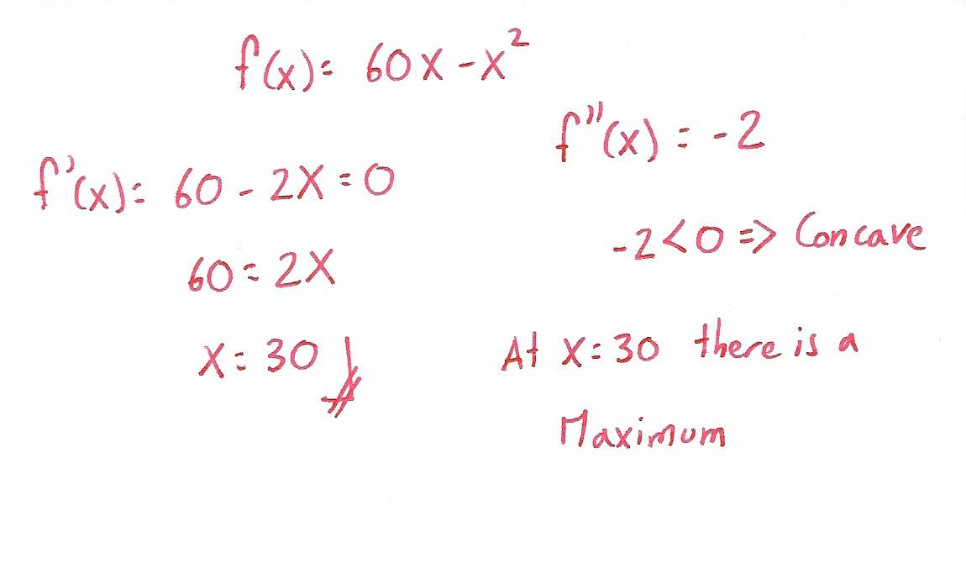
Problem 1:
Problem 1:
Find the point where there is a maximum or minimum, and determine if it is a maximum or minimum.

Slide 16
Problem 1:
Problem 1:
Find the point where there is a maximum or minimum, and determine if it is a maximum or minimum.

Slide 17
QUESTIONS?

